Slide 1
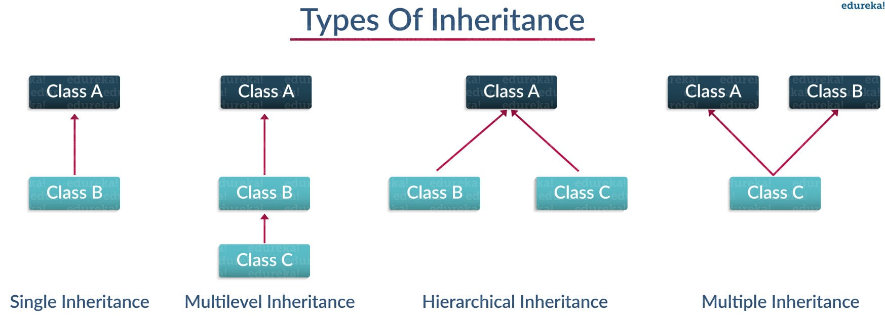
OOPs (Inheritance)
Inheritance: It generally means “transfer of characteristics from parent to child class without any modification”. The new class is called the derived/child class and the one from which it is derived is called parent/base class.

Slide 2
Single Inheritance
Single level inheritance enables a derived class to inherit characteristics from a single parent class
Example: class employee1(): # This is a parent class def__init__(self, name, age, salary): self.name = name self.age = age self.salary = salary class childemployee(employee1): # This is a child class def__init__(self, name, age, salary,id): self.name = name self.age = age self.salary = salary self.id = id emp1=employee1(‘harshit’,22,1000) print(emp1.age) Output : 22

Slide 3
Ex2: The ch1 object is an instance of the child class, but it has an access to data attributes and methods described by both Parent and Child classes
Parent class created class Parent: parentname = “ ” childname = “ ”
def show_parent(self): print(self.parentname)
# Child class created inherits parent class
class Child(Parent): def show_child(self): print(self.childname)
ch1=Child() # Object of child class
ch1.parentname = “Mark”
ch1.childname=“John”
ch1.show_parent()
ch1.show_child()

Slide 4
Multilevel Inheritance: It enables a derived class to inherit properties from immediate parent class which inturn inherits properties from his parent class
Example 1
class employee(): def__init__(self, name, age, salary): self.name = name self.age = age self.salary = salary class childemployee1(employee): def__init__(self, name, age, salary): self.name = name self.age = age self.salary = salary class childemployee2(childemployee1): def__init__(self, name, age, salary): self.name = name self.age = age self.salary = salary emp1=employee(“karshit”, 33, 4500) emp2=childemployee1(“darshit”, 31, 5500)
print(emp1.salary) print(emp2.age)

Slide 5
Ex2 : Son class inherited from Father and Mother class which derived from Family Class
class Family(): def show_family(self): print(“This is our family”)
# Father class inherited from family class Father(Family): fathername = “ “ def show_father(self): print(self.fathername)
# Mother class inherited from family class Mother(Family): mothername = “ “ def show_mother(self): print(self.mothername)
# Son class inherited from Father and Mother classes class Son(Father,Mother): def show_parent(self): print(“Father”, self.fathername) print(“Mother”, self.mothername) s1 = Son() # Object of son class s1.fathername = “Mark” s1.mothername = “Sonia” s1.show_family() s1.show_parent()

Slide 6
Hierarchical Inheritance: enables more than one derived class to inherit properties from a parent class
class employee(): def__init__(self, name, age, salary): self.name = name self.age = age self.salary = salary class childemployee1(employee): def__init__(self, name, age, salary): self.name = name self.age = age self.salary = salary class childemployee2(employee): def__init__(self, name, age, salary): self.name = name self.age = age self.salary = salary emp1=employee(“karshit”, 33, 4500) emp2=employee(“darshit”, 31, 5500)
print(emp1.salary) print(emp2.age)

Slide 7
Multiple Inheritance
Multilevel Inheritance enables one derived class to inherit properties from more than one base class
Ex: class employee1(): def__init__(self, name, age, salary): self.name = name self.age = age self.salary = salary class employee2(): def__init__(self, name, age, salary,id): self.name = name self.age = age self.salary = salary self.id = id class childemployee(employee1,employee2): def__init__(self, name, age, salary, id): self.name = name self.age = age self.salary = salary self.id = id emp1=employee1(“harsh”,33,2345) emp2=employee2(“karsh”,44,5432) print(emp1.age) print(emp2.id)

